Slide 1
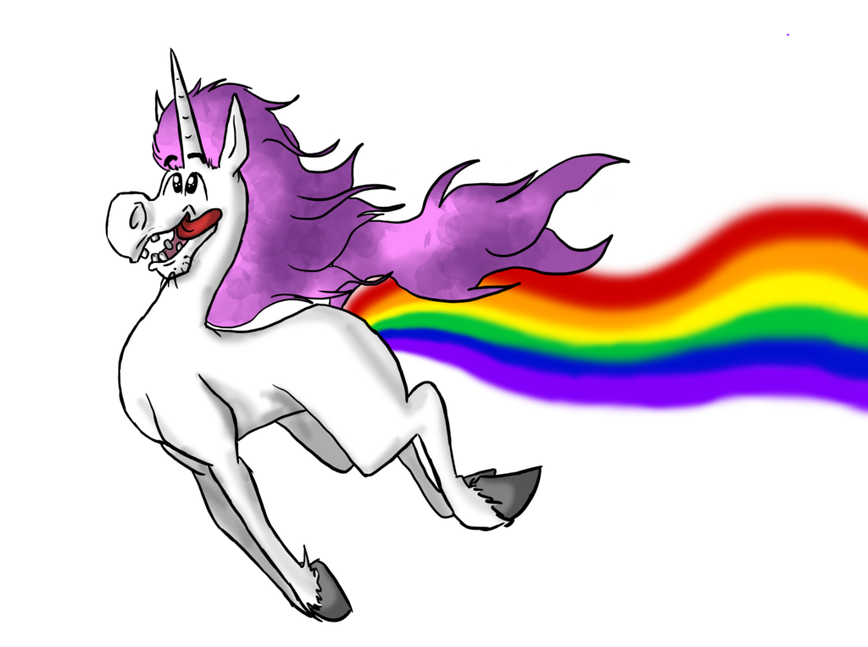
Task Manager
Be Yourself, Reward Yourself!

Slide 2
Team Members
Project Manager
Pallavi Dacre
Frontend Layout
Mark Nguyen Pallavi Dacre
Functionality | API | Database
Steffen J. Camarato Dennis Gebken Adam Henderson | Alexander Hunt Matthew Bonsignore Pallavi Dacre | Matthew Bonsignore

Slide 3
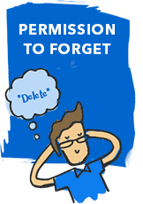
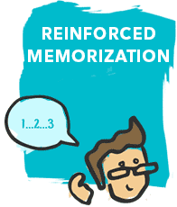
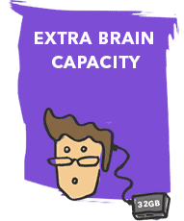
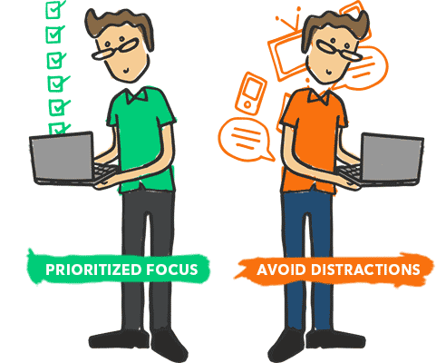
How useful are task managers?
Every time you look at a task, it reinforces the information in your short-term memory.
Students are often encouraged to use lists as study aids to increase retention of facts.
Feeling forgetful? Task managers are a useful external memory aid that give you permission to forget.
Increase in productivity
Help you focus your attention on the most important task of the moment.
Increase in motivation
As you succeed at each step along the way, you'll gain confidence crossing those items off your list!
The average person’s short-term memory can only hold 7 pieces of information for about 30 seconds.
Keeping a task manager will allow you to effortlessly keep track of everything that you need to do.

Slide 4
How useful are task managers cont.
3.5 out of 10 Americans utilize a task manager
* Fake claims based on a research study of 3,561 people from the University of Texas at Austin, Mr. Art Markman PhD. of Psychology

Slide 5
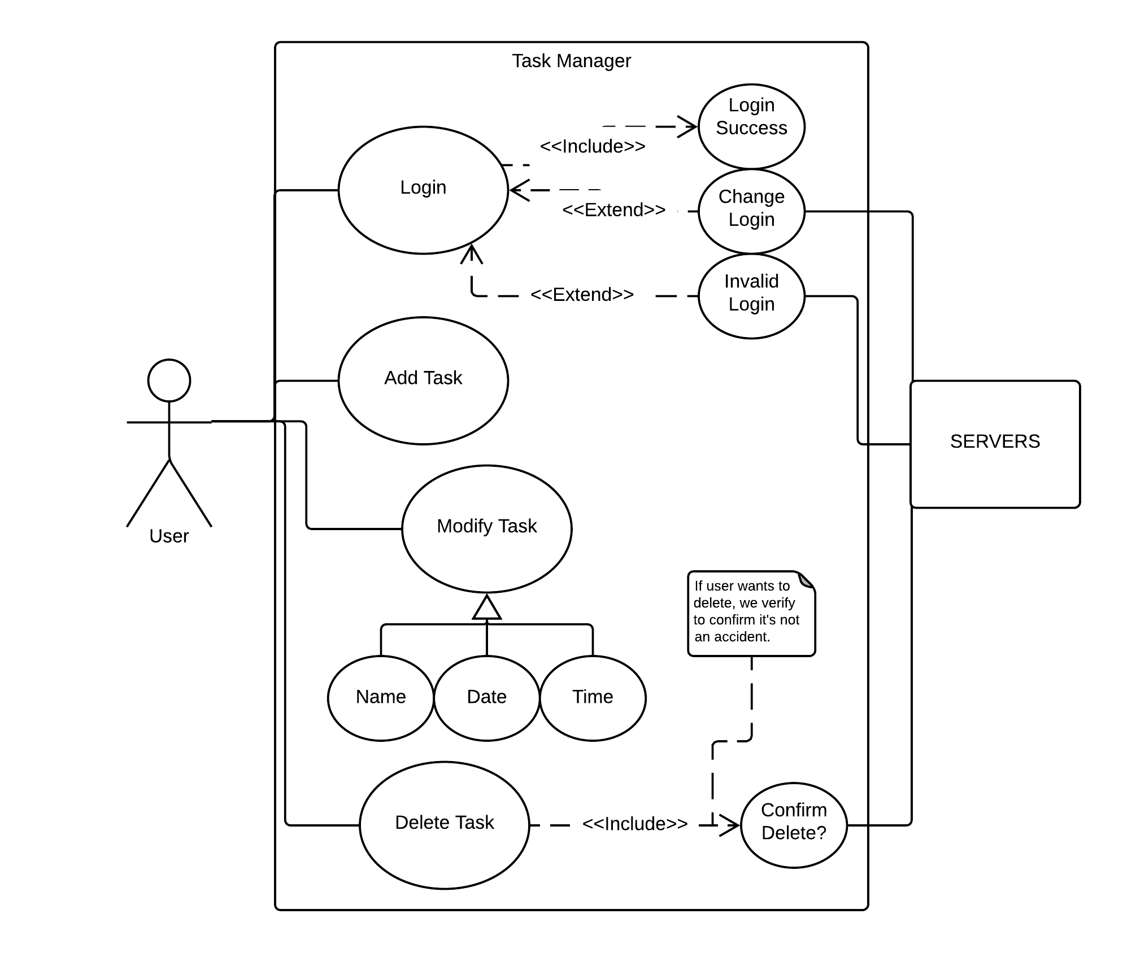
Our Task Manager (Use Case Diagram)
User first creates an account
The user is able to add tasks and delete tasks
Modifying tasks are simple and allows the user to update their tasks or mark them as completed

Slide 6
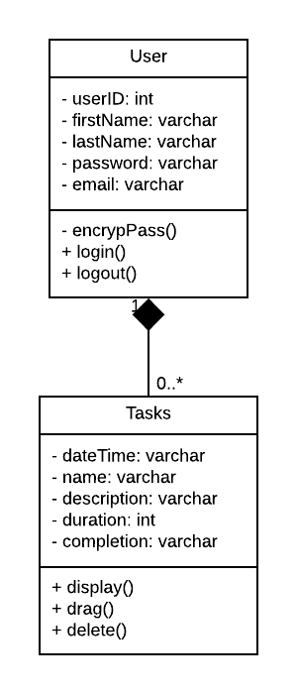
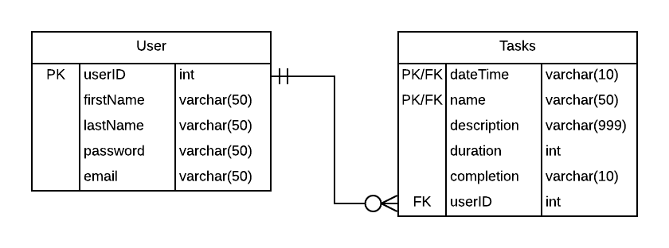
Our Task Manager (Class / ER Diagram)
We can have one user which can assign zero to many tasks.
Different methods allow to customize the viewing of the tasks, such as drag and drop features.
userID is the primary key for the user class while a composite key is used for the tasks class as a task name/date will be a unique combination.

Slide 7
So what makes ours different?

Slide 8


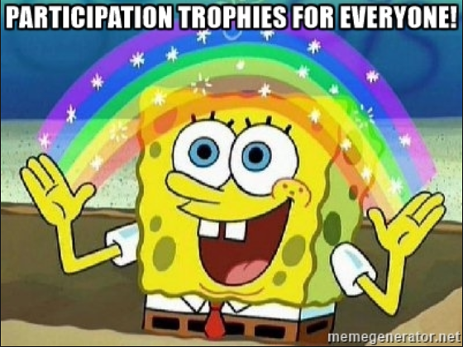

Designed for Millennials!
Wow! You completed 10 Tasks!
REWARD YOURSELF!
Congrats on Signing up!
You Logged Your First Task!
Amazing, you woke up today!

Slide 9
Questions?

